Slide 1
CONSUMER BEHAVIOUR AND MARKETING STRATEGY
By (Write Your Name Here)

Slide 2
Consumer Behaviour and Marketing Strategy
Consumer Behaviour has to do with How customers make decisions in the market.
It involves how they select, buy and even dispose products and services of a business.
Marketing strategy is a plan on how to reach and turn potential customers into actual consumers or customers of a business product or service
An effective marketing strategy analyzes the consumer behaviour in the market.
Therefore, businesses use consumer behaviour to strategize their marketing methods, channels and marketing statements.

Slide 3
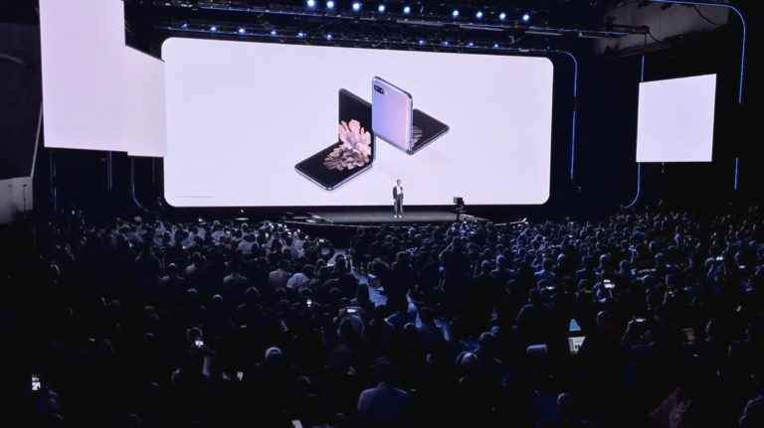
Current Event: Samsung Galaxy Unpacked 2020
One marketing event that shows understanding of consumer behaviour is the Samsung Galaxy Unpacked.
This event happened on 11th February 2020 in San Francisco, USA.
It involved the launch of Galxy S20 5G, S20+ 5G, S20 Ultra 5G and Galaxy Z Flip.

Slide 4
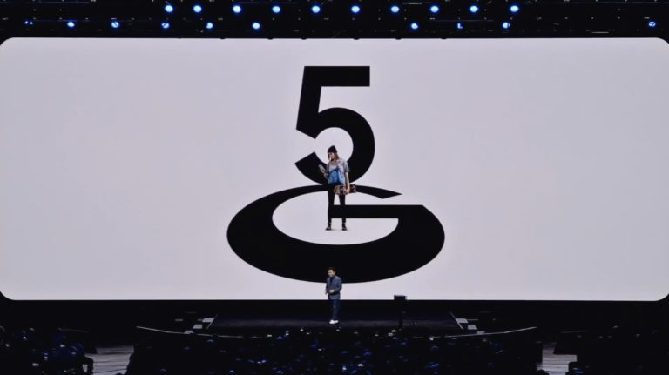
Manager Application
Main learning point: Samsung understands the consumer behaviour regarding choosing and buying smartphones and uses the need for high speed to tailor their marketing and production.
As a manger, I can apply what I have learned from the event in an organization by creating awareness of every new products through launch events.

